Slide 1
POGIL DATA ANALYSIS
Group Members:
Priyanshu Singh 53
Yash Sarang 47
Arnav Singhal 56

Slide 2
POGIL
Process Oriented Guided Inquiry Learning (POGIL) is a student-centered, group-learning instructional strategy and philosophy developed through research on how students learn best.
There are two crucial aspects to the design of a POGIL activity. First, sufficient appropriate information must be provided for the initial "Exploration" so that students are able to develop the desired concepts. Second, the guiding questions must be sequenced in a carefully constructed manner so that students not only reach the appropriate conclusion, but also develop various process and learning skills.
POGIL activities follow the structure of the learning cycle of exploration, concept invention, and application.
POGIL is implemented in a wide range of subjects in more than 1,000 American high schools and colleges.

Slide 3
CLASSROOM IMPLEMENTATION
Students in a POGIL classroom may work in small groups of three or four to tackle a specifically designed activity. Each student is assigned a role, such as a task manager, recorder, spokesperson or reflector.
The instructor acts as a facilitator who listens to the discussions between students, intervening at appropriate times to help facilitate student learning. In their groups, students may discuss and analyze problems and their answers to questions that are crafted to help lead them to consider the general ideas in question and to construct their own understanding of important concepts.
Rather than having the instructor begin class by defining terms and laying out concepts, students work actively to master material and formulate a deeper understanding of content. Built into the experience is the support of a variety of important process skills, including communication, teamwork, and critical thinking, which translates to a more complete understanding of the entire concept, and a lasting understanding of the material.

Slide 4

ACTIVITES

Slide 5
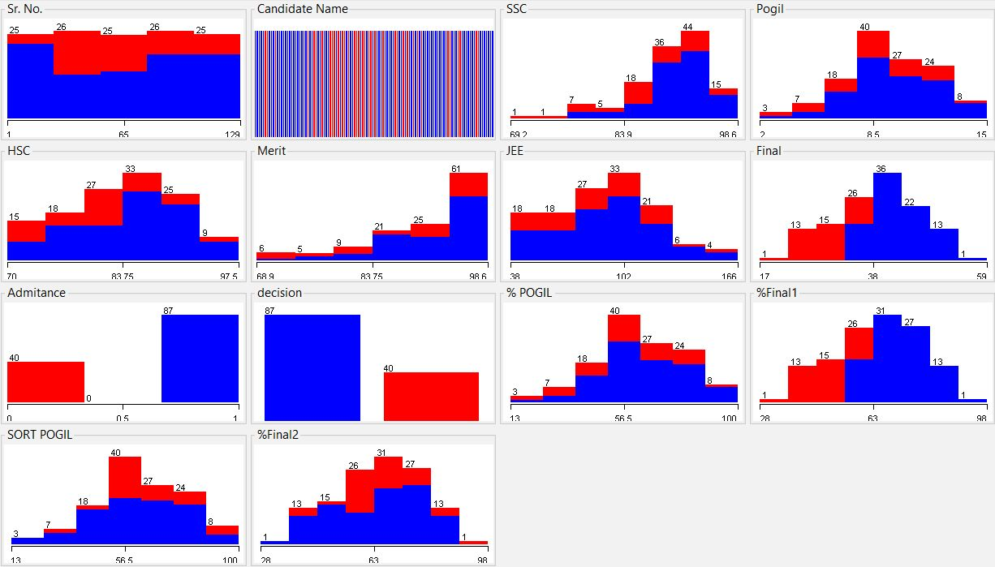
Data Analysis with POGIL using WEKA

Slide 6
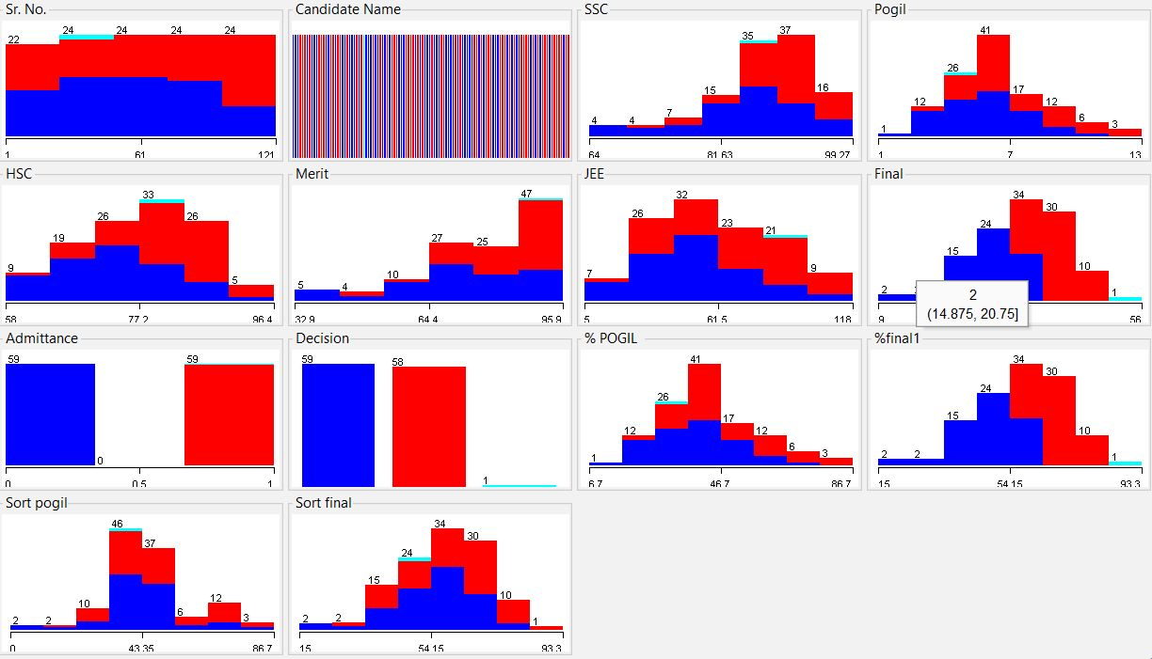
Data Analysis Without POGIL using WEKA

Slide 7
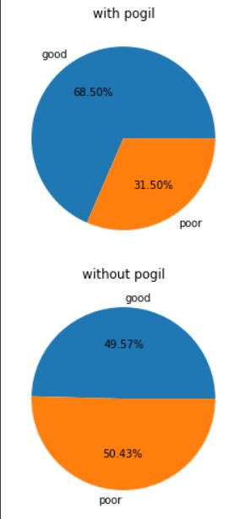
Comparison With Pie Diagram in Python

Slide 8
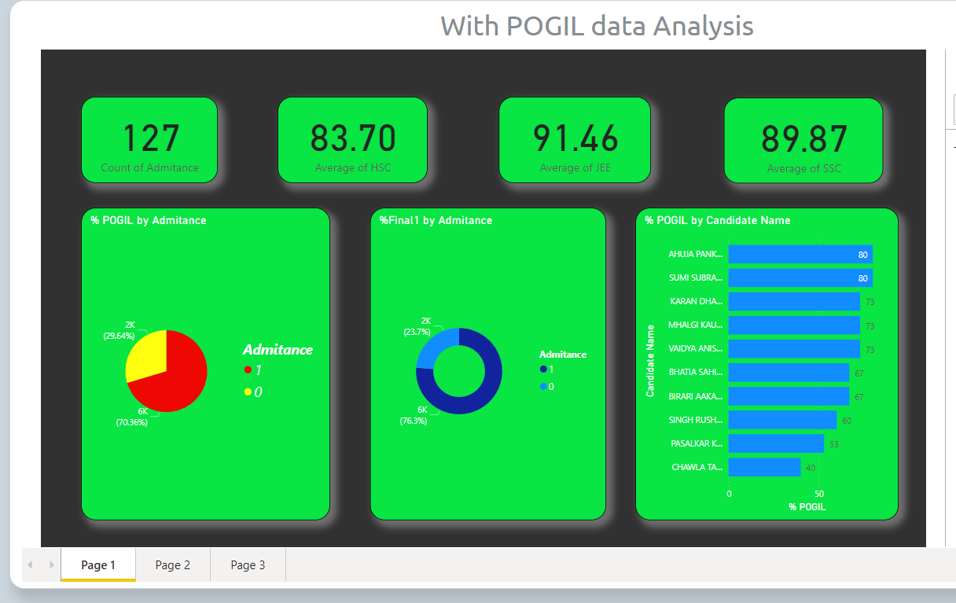
Analysis With POGIL on Webpage

Slide 9
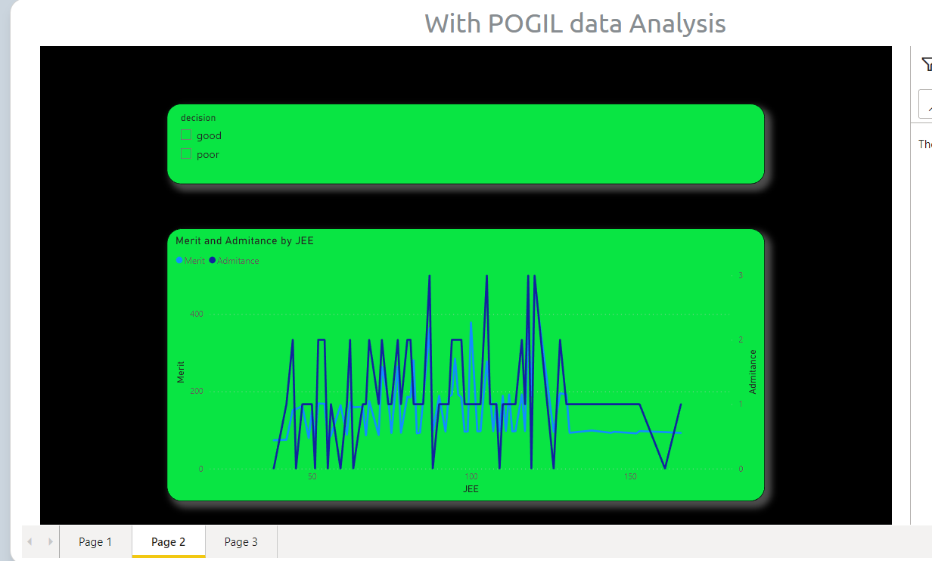
Graph of Merit And Admittance By JEE

Slide 10
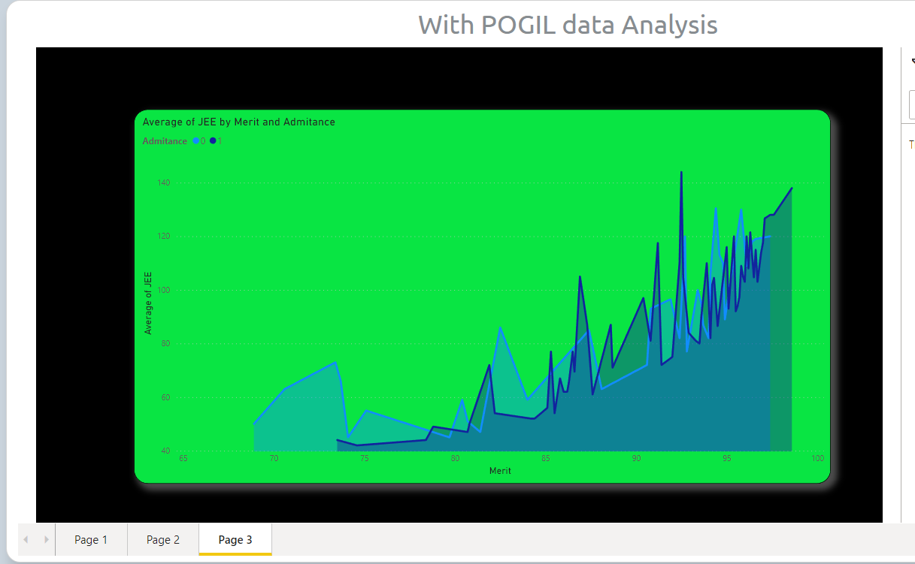
Average Of JEE By Merit and Admittance

Slide 11
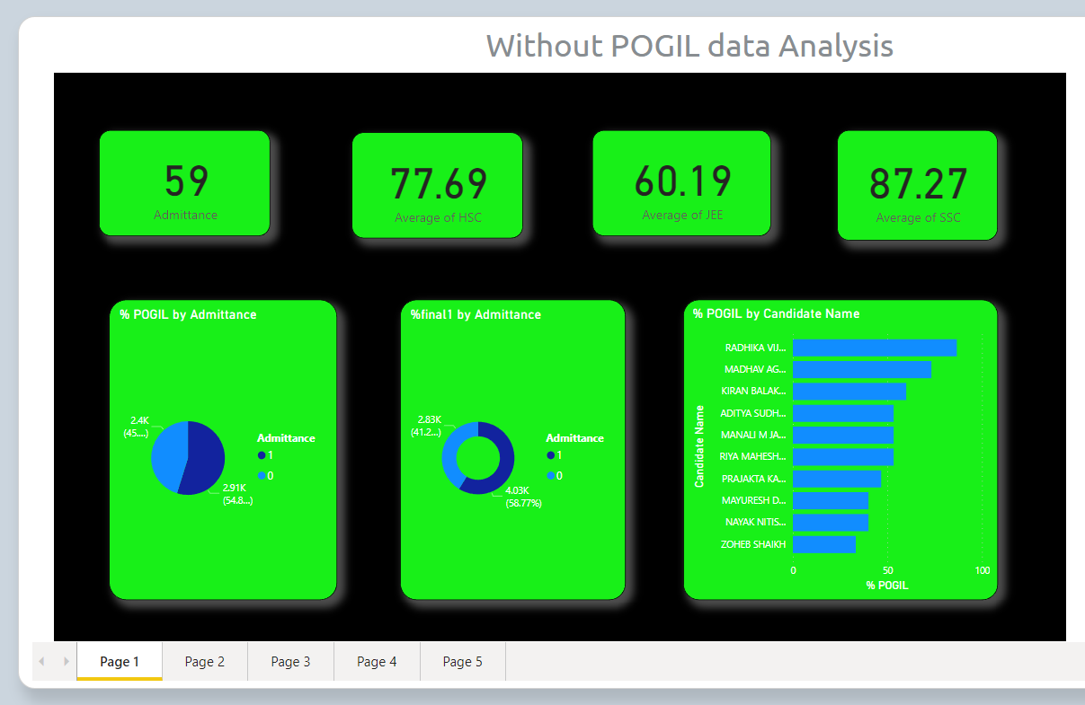
Analysis without POGIL On Webpage

Slide 12
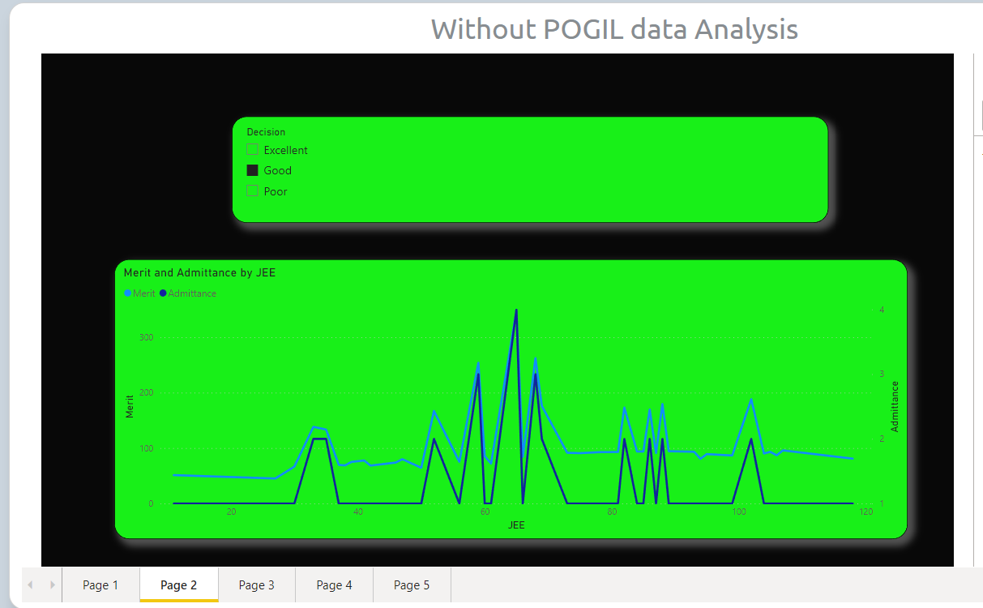
Graph of Merit And Admittance By JEE

Slide 13
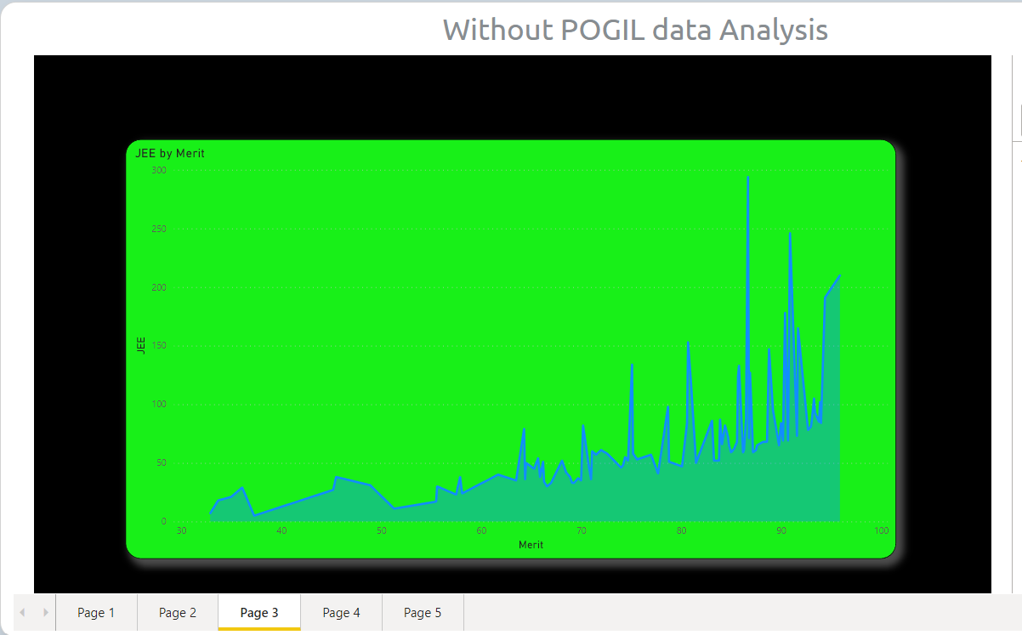
Graph Of JEE By Merit

Slide 14

Output

Slide 15

output

Slide 16

output

Slide 17

output

Slide 18
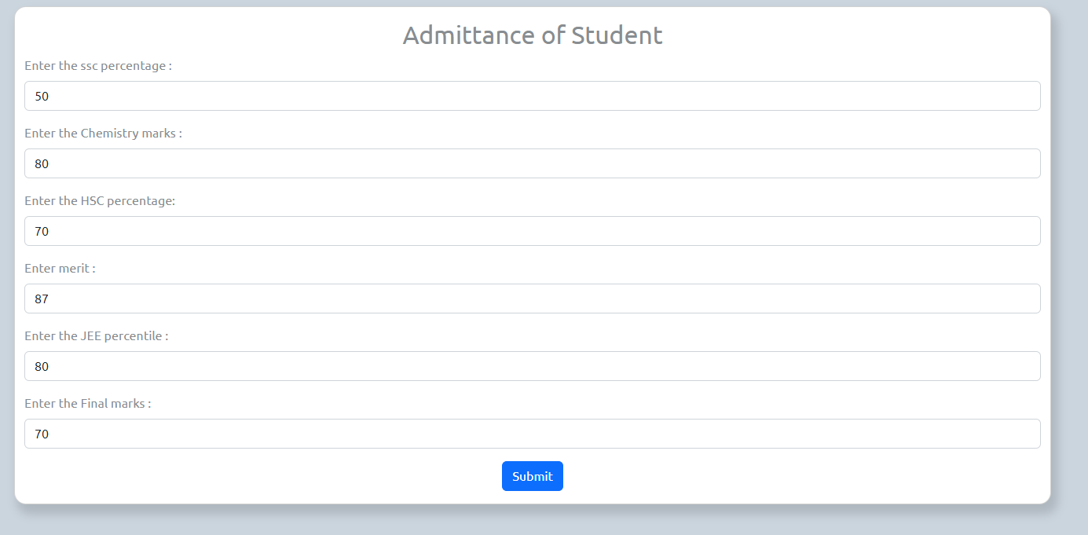
output

Slide 19
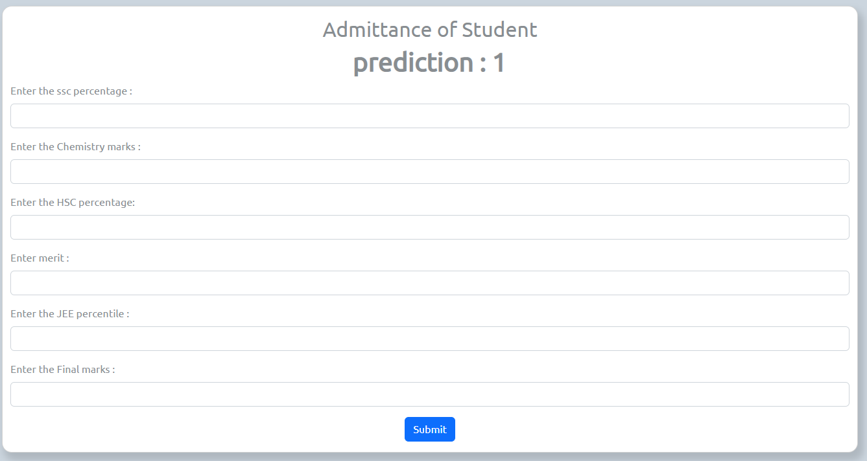
output

Slide 20
CONCLUSION
POGIL class is more efficient than the traditional chalk and board Method as per students feedback
POGIL provides opportunities for improving process skills during content learning through guided-inquiry activities, to standard lecture conditions.
POGIL class has been introduced in restructured FE curriculum similar to tutorial classes for subjects during the semesters.

